Slide 1
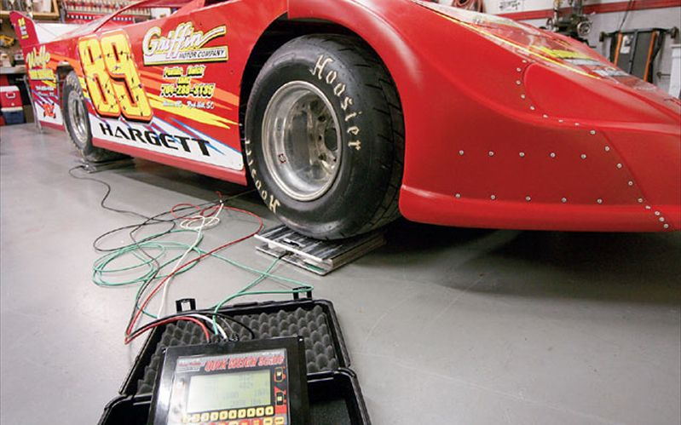
Predicting Car Weight from Machine Learning.
Rakshith Vasudev

Slide 2

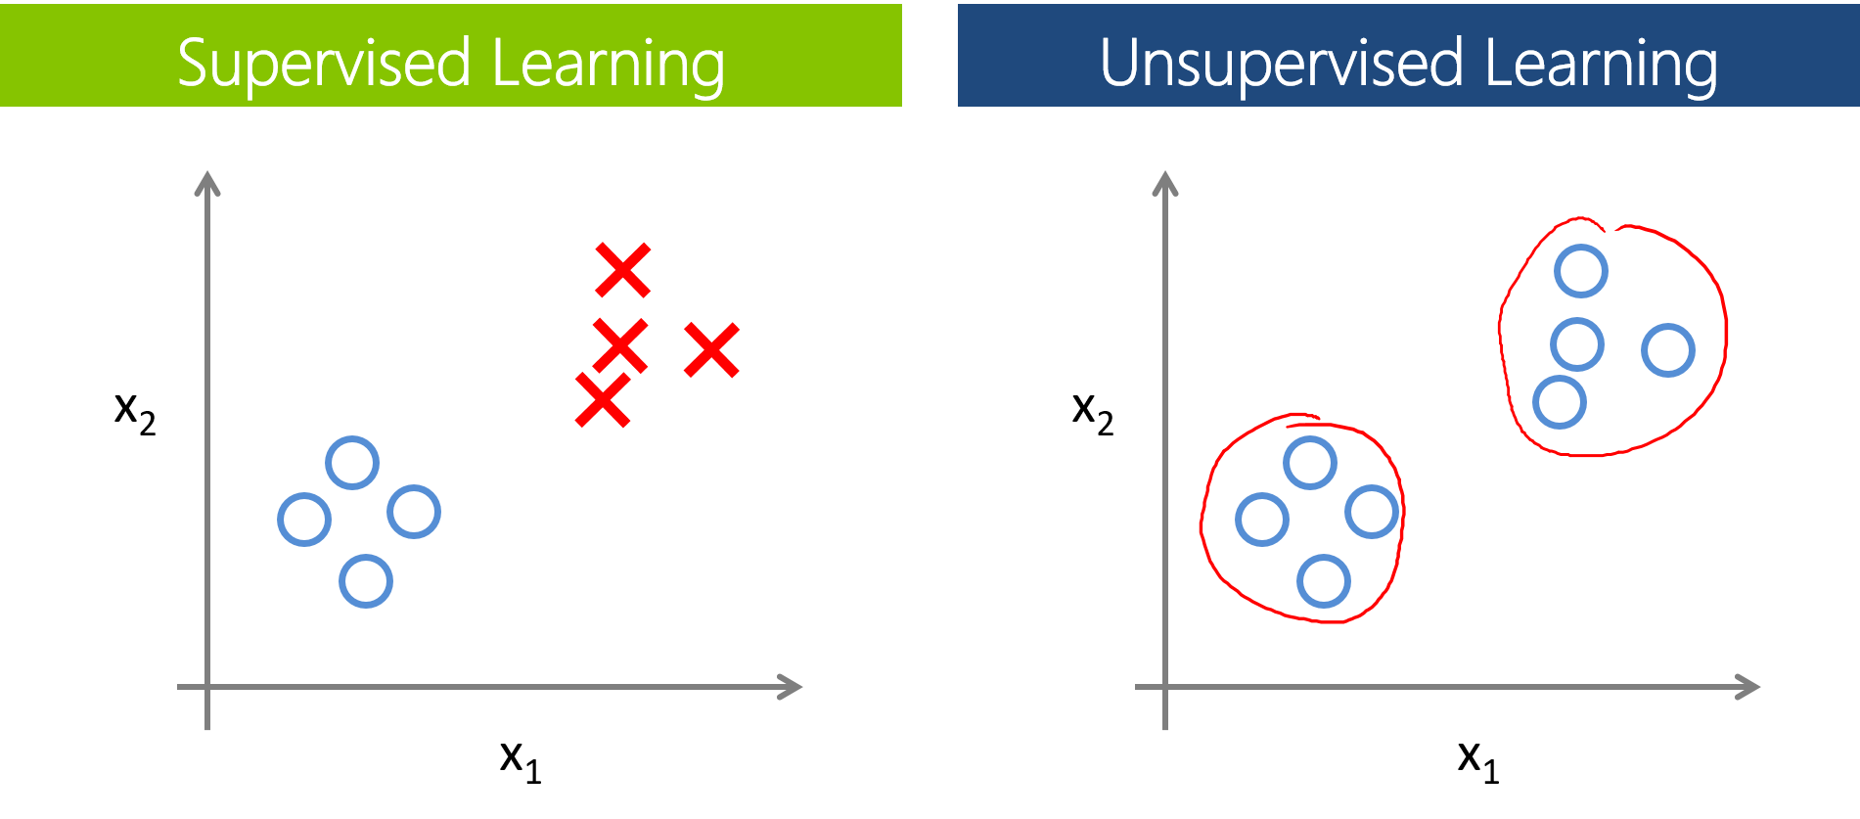
Machine Learning has broadly 3 Categories.
Supervised Learning.
Unsupervised Learning.
Reinforcement Learning.

Slide 3
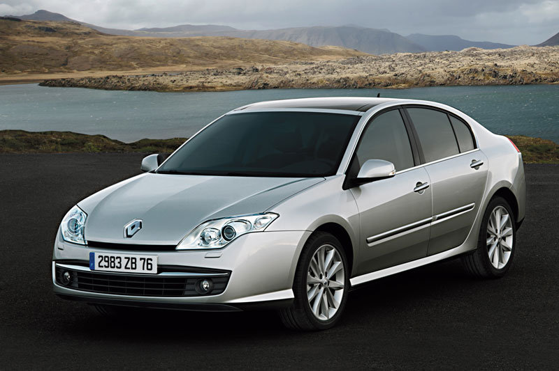
We’re going to discuss Supervised ML.
Problem Description: To predict weight of a car, based on the displacement.

Slide 4
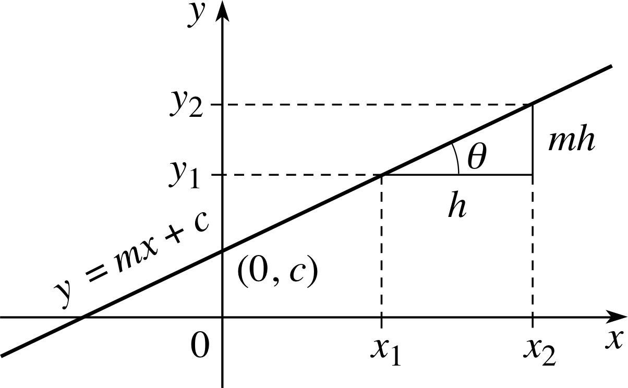
Simple Linear Regression helps to predict values.

Slide 5
X: Displacement(cc) vs Y: Weight(lbs)

Slide 6

Follow me on Youtube for more ML tuts
Rakshith Vasudev

